Slide 1
THE SCIENCE OF SIN AND SALVATION
Copyright Robert Melashenko 2013
All Rights Reserved

Slide 2
Lecture One
“Setting the Table”

Slide 3
There are over 3000 religious denominations in the US today. Why so many? Why is there so much disagreement about sin and salvation?
Can you define sin in a manner that everyone in this room would agree with you?
Consequently, if even a small group cannot agree on “What went wrong”, how can we ever agree on “How to fix it”?
So, if we aren’t sure about “How to fix it”, then how can we be sure of our salvation?

Slide 4
Is the answer to just accept that God loves us, and we love Him, so everything will be okay?
For God so loved the world, that he gave his only begotten Son, that whoever believes in him should not perish, but have everlasting life. (John 3:16 AKJV)

Slide 5
But then what about the people Christ talks about in Matthew 7:21-23?
Not everyone that said to me, Lord, Lord, shall enter into the kingdom of heaven; but he that does the will of my Father which is in heaven. Many (much, large) will say to me in that day, Lord, Lord, have we not prophesied in your name? and in your name have cast out devils? and in your name done many wonderful works? And then will I profess to them, I never knew you: depart from me, you that work iniquity. (Matthew 7:21-23 AKJV)

Slide 6
God’s love is what moved Him to make the plan of salvation—it is not the plan of salvation!
He that has my commandments, and keeps them, he it is that loves me: and he that loves me shall be loved of my Father, and I will love him, and will manifest myself to him.
      (John 14:21 AKJV)

Slide 7
Therefore “keeping the commandments” must be the basis of salvation!
For by grace are you saved through faith; and that not of yourselves: it is the gift of God: Not of works, lest any man should boast. (Ephesians 2:8-9 AKJV)
This must be true, because as we have seen in Matthew 7:21, there are a host of people who have not just mowed their neighbor’s lawn, but have “prophesied” and “cast out devils” and done “wonderful works”, but are told “I never knew you: depart from me”.

Slide 8
Could “forgiveness” then be what salvation is all about?
If so, why should the human race after Adam and Eve need to ask for forgiveness for something they were born with? To ask for forgiveness implies causality.
Then said Jesus, Father, forgive them; for they know not what they do. And they parted his raiment, and cast lots.
(Luke 23:34 AKJV)
This prayer was for every human that has ever lived. That means that billions of God’s children will die forgiven in the end (see again Matthew 7:21-23).

Slide 9
Could it be that a number of God’s children who perish in the end will claim to have loved Him, will have done many good works, and will have asked for forgiveness of sins?
WHERE DID THEY GO WRONG?
ARE WE DIFFERENT FROM THEM?
ARE THERE ANSWERS TO THESE QUESTIONS?

Slide 10
Before going forward we need to establish some definitions and assumptions which will be used throughout the presentations.

Slide 11
It is necessary to define the goal and trustworthy sources to reach the goal.
OUR GOAL:
OUR SOURCES:
TO GET THE “TRUTH” ABOUT SIN AND SALVATION.
THE BIBLE
SCIENCE

Slide 12
DEFINITIONS
Truth
Law

Slide 13
Truth
“Truth is that which is” - Aristotle

Slide 14
Jesus said to him, I am the way, the truth, and the life: no man comes to the Father, but by me. (John 14:6 AKJV)
Sanctify them through your truth: your word is truth. (John 17:17 AKJV)
In the beginning was the Word, and the Word was with God, and the Word was God.
        (John 1:1 KJV)
Your righteousness is an everlasting righteousness, and your law is the truth. (Psalms 119:142 AKJV)

Slide 15
Christ = God’s Word = God’s Law = That Which Is
For the word of the LORD is right; and all his works are done in truth.
(Psalms 33:4 AKJV)

Slide 16
By the word of the LORD were the heavens made; and all the host of them by the breath of his mouth. (Psalms 33:6 AKJV)
For he spoke, and it was done; he commanded, and it stood fast. (Psalms 33:9 AKJV)
Everything in our universe (including ourselves) is the direct result of God’s Word.
In hope of eternal life, which God, that cannot lie, promised before the world began;
(Titus 1:2 AKJV)

Slide 17
God “creates” reality through His Word.
In the beginning was the Word, and the Word was with God, and the Word was God. The same was in the beginning with God. All things were made by him; and without him was not any thing made that was made. (John 1:1-3 AKJV)
And he humbled thee, and suffered thee to hunger, and fed thee with manna, which thou knewest not, neither did thy fathers know; that he might make thee know that man doth not live by bread only, but by every word that proceedeth out of the mouth of the LORD doth man live.
  (Deuteronomy 8:3 KJV)

Slide 18
LAW
Extrinsic—the law is a means to an end.
Intrinsic—the law is a description of reality.

Slide 19
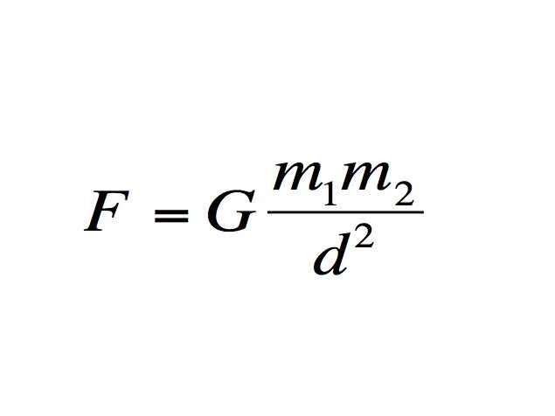

Slide 20
Think not that I am come to destroy the law, or the prophets: I am not come to destroy, but to fulfill (ploroo= to make full , bring to realization). For truly I say to you, Till heaven and earth pass, one stroke or one pronunciation mark shall in no wise pass from the law, till all be fulfilled (ginomai = come into existence). (Matthew 5:17-18 AKJV)
This text tells us that the Law is intrinsic, for to break it would cause “heaven and earth to pass away”.
God’s Law then includes the Three Laws of Thermodynamics, the laws of Physics, Chemistry, Math etc.

Slide 21
Thou art near, O LORD; and all thy commandments are truth.
(Psalms 119:151 KJV)
The Ten Commandments represented a special addendum updating God’s Law (defines reality) once sin (Not His code) has entered the picture:
Why then serves the law? It was added because of transgressions, till the seed should come to whom the promise was made; and it was ordained by angels in the hand of a mediator. (Galatians 3:19 AKJV)
This “update” will remain in place until the adversary’s code (sin) is removed by Christ at the very end of time.

Slide 22
And it shall come to pass, when you be multiplied and increased in the land, in those days, said the LORD, they shall say no more, The ark of the covenant of the LORD: neither shall it come to mind: neither shall they remember it; neither shall they visit it; neither shall that be done any more.
(Jeremiah 3:16 AKJV)

Slide 23
The addendum (Ten Commandments) will define God’s Law to humans in the sinful condition:
Therefore by the deeds of the law there shall no flesh be justified in his sight: for by the law is the knowledge of sin. (Romans 3:20 AKJV)

Slide 24
ASSUMPTIONS
Since the Bible is the one source that describes and defines both sin and salvation, it will be our source of “truth” in these matters. Science has nothing to say about either topic.
The Bible is to be read plainly unless it indicates otherwise.
The Bible is the inspired word of God.
We have also a more sure word of prophecy; whereunto you do well that you take heed, as to a light that shines in a dark place, until the day dawn, and the day star arise in your hearts: Knowing this first, that no prophecy of the scripture is of any private interpretation. For the prophecy came not in old time by the will of man: but holy men of God spoke as they were moved by the Holy Ghost.
(2 Peter 1:19-21 AKJV)

Slide 25
ASSUMPTIONS Cont:
God has preserved his Word.
The words of the LORD are pure words: as silver tried in a furnace of earth, purified seven times. You shall keep them, O LORD, you shall preserve them from this generation for ever.
(Psalms 12:6-7 AKJV)
The whole Bible is to be utilized.
And he said to them, These are the words which I spoke to you, while I was yet with you, that all things must be fulfilled, which were written in the law of Moses, and in the prophets, and in the psalms, concerning me.
(Luke 24:44 AKJV)

Slide 26
The Bible explains its self.
Whom shall he teach knowledge? and whom shall he make to understand doctrine? them that are weaned from the milk, and drawn from the breasts. For precept must be upon precept, precept upon precept; line upon line, line upon line; here a little, and there a little: (Isa 28:9-10)

Slide 27
“How Readest thou?”
Let him which is on the housetop not come down to take any thing out of his house:
(Matthew 24:17 KJV)
Let him which is on the house[top not come down] to take any thing out of his house:
(Matthew 24:17 KJV)

Slide 28
I never promised you the money.
I never promised you the money.
I never promised you the money.
I never promised you the money.
I never promised you the money.
I never promised you the money.
I never promised you the money.

Slide 29
One reason that the Bible is hundreds of pages in length is that each topic is covered in more than one place. One must bring into play everything that the Bible has to say on a subject before coming to a conclusion.
And I say also to you, That you are Peter (petros), and on this rock (petra) I will build my church; and the gates of hell shall not prevail against it.
And I will give to you the keys of the kingdom of heaven: and whatever you shall bind on earth shall be bound in heaven: and whatever you shall loose on earth shall be loosed in heaven.
(Matthew 16:18-20 AKJV)

Slide 30
What definition does Christ make very plain at the outset?
And he brought him to Jesus. And when Jesus beheld him, he said, You are Simon the son of Jona: you shall be called Cephas, which is by interpretation, A stone (petros).
(John 1:42 AKJV)

Slide 31
What else does Christ have to say on the subject?
But Jesus called them to him, and said, You know that the princes of the Gentiles exercise dominion over them, and they that are great exercise authority on them. But it shall not be so among you: but whoever will be great among you, let him be your minister; And whoever will be chief among you, let him be your servant:
(Matthew 20:25-27 AKJV)

Slide 32
Christ only refers to Peter as “petros”, as does the rest of the NT (159 times). Christ never calls Peter “petra” anywhere else in the four gospels. He refers to Himself as “petra” as shown in the following text:
Therefore whoever hears these sayings of mine, and does them, I will liken him to a wise man, which built his house on a rock (petra):
(Matthew 7:24 AKJV)

Slide 33
Peter only refers to Christ as either “lithos” or “petra”
To you therefore which believe he is precious: but to them which be disobedient, the stone (lithos) which the builders disallowed, the same is made the head of the corner, And a stone (lithos) of stumbling, and a rock (petra) of offense, even to them which stumble at the word, being disobedient: whereunto also they were appointed.
(1Peter 2:7-8)

Slide 34
Is there another way to interpret Matthew 16:18?
And I say also to you, That you are Peter (petros), and on this rock (petra) I will build my church; and the gates of hell shall not prevail against it.

Slide 35
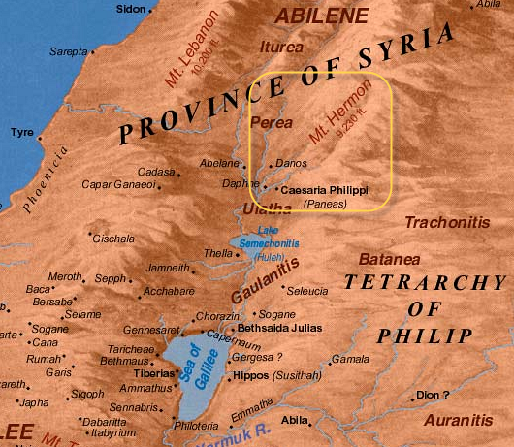

When Jesus came into the coasts of Caesarea Philippi, he asked his disciples, saying, Whom do men say that I the Son of man am? (Matthew 16:13 AKJV)

Slide 36
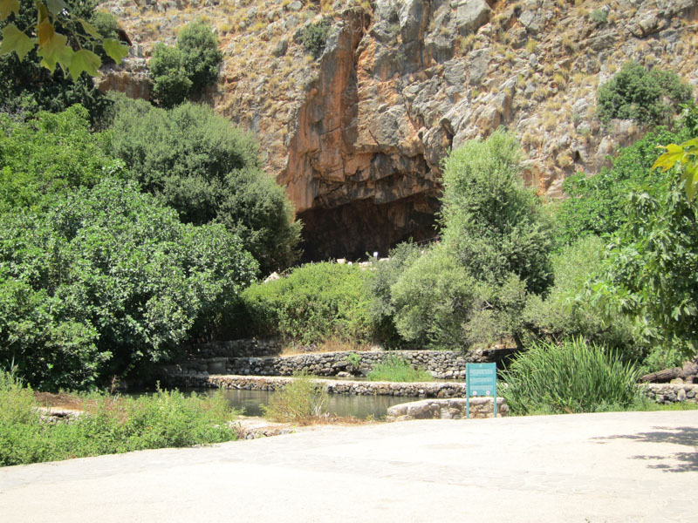
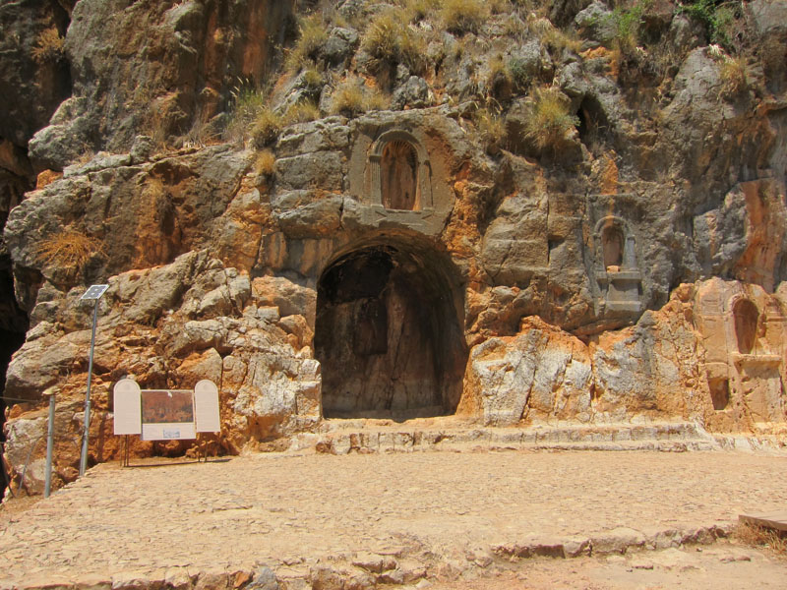
“Gates of Hell”

Slide 37
What then could be the meaning of Matthew 16:19?
And I will give to you the keys of the kingdom of heaven: and whatever you shall bind on earth shall be bound in heaven: and whatever you shall loose on earth shall be loosed in heaven.
And when he was demanded of the Pharisees, when the kingdom of God should come, he answered them and said, The kingdom of God comes not with observation: Neither shall they say, See here! or, see there! for, behold, the kingdom of God is within you. (Luke 17:20-21 AKJV)
Then shall the King say to them on his right hand, Come, you blessed of my Father, inherit the kingdom prepared for you from the foundation of the world:
(Matthew 25:34 AKJV)

Slide 38
PARADIGM
what is to be observed and scrutinized
the kind of questions that are supposed to be asked and probed for answers in relation to this subject
how these questions are to be structured
how the results of scientific investigations should be interpreted
how is an experiment to be conducted, and what equipment is available to conduct the experiment.

